Slide 1
Tax Coordination in Europe: Assessing the first years of the EU-Savings Taxation Directive
Thomas Hemmelgarn and Gaetan Nicodème - 2009
Rakesh NICHANAMETLA

Slide 2
Preliminary Concepts
Tax competition and Tax coordination
Savings Income Taxation
Withholding Tax
Various groups – EU, BIS reporting countries, Third countries
Grandfathering

Slide 3
Introduction
Tax competition and Tax coordination - its long tradition in public economics: e.g. seen in the ongoing currency wars
Few examples of Tax coordination including this Directive due to complexities of international consensus

Slide 4
The EU-Savings Taxation Directive – Council Directive 2003/48/EC
Into effect from 1 July 2005
The European Union is pursuing its ultimate goal of enabling interest on savings received in one Member State by individuals who are resident for tax purposes in another Member State to be made subject to effective taxation in accordance with the laws of the latter Member State.

Slide 5
Aim of the Directive
As part of the "tax package" aimed at combating harmful tax competition, the European Community (EC) decided to draw up a legislative instrument to overcome existing distortions in the effective taxation of savings income in the form of interest payments.
In a nutshell – discourage tax evasion due to free capital movement - distorts internal market - tax pressure on immobile sources like labor increases labor costs employment

Slide 6
Scope of application
"interest paid or credited to an account, relating to debt claims of every kind, whether or not secured by mortgage and whether or not carrying a right to participate in the debtor's profits, and, in particular, income from government securities and income from bonds or debentures, including premiums and prizes attaching to such securities, bonds or debentures; penalty charges for late payments shall not be regarded as interest payments.“
+ 3 more categories

Slide 7
Functioning (1) – Paying Agents and Geographical Scope
Limited to EU + ...
Equivalent measures for 5 third countries – Andorra, Liechtenstein, Monaco, San Marino and Switzerland
And to 10 dependant territories (Cayman Islands, British Virgin Islands, Jersey, Isle of Man etc.)

Slide 8
Functioning (2) – Beneficial Owner
"any individual who receives an interest payment or any individual for whom an interest payment is secured“
Applies to only individuals and not companies or other legal persons – outcome “discretionary” funds

Slide 9
Functioning (3) – Definition of Interest Income
Grandfathering of debt instruments
Innovative financial vehicles with capital protection and life-insurance products

Slide 10
Empirical evidence

Slide 11
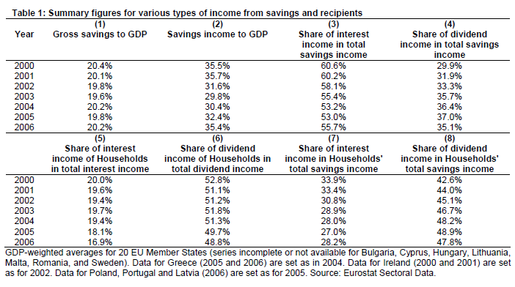
Empirical evidence

Slide 12
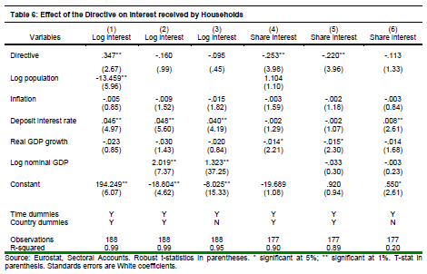
Empirical Evidence

Slide 13
Proposed Amendments
Using the Anti-Money Laundering Directive
Include all sorts of investment vehicles to which the directive is applicable
Automatic exchange of information applied to Belgium, Luxembourg and Austria

Slide 14
Conclusion
Despite poor data availability, the analysis suggests that the Directive had no significant effects on the development (evolution) of investment patterns which fall under this scope.
In any case, the insignificant effect could be explained due to the several loopholes suffered by the Directive.

