Slide 1
Public Economics (Master PPD & APE, Paris School of Economics) T. Piketty Academic year 2016-2017
Lecture 1: State formation & taxation in historical perspective
(check on line for updated versions)

Slide 2
Roadmap of lecture 1
State formation & govt regulation in history
Standard economic rationales for taxes & transfers
Basic facts about taxes & transfers in rich countries
On the structure of taxes in EU countries
Basic facts about taxes in developing countries
Optimal policy: social objective vs incidence
Tax and transfer incidence: macro perspective
Tax and transfer incidence micro perspective

Slide 3
State formation & government regulation in historical perspective
The objective of this course is to present an introduction to public economics, with special emphasis on the history of taxation, public spending and state formation, normative theories of government intervention & redistribution, and the incidence of tax and transfer policies, both in developed countries and in the developing world
The rise of the fiscal and social state (taxes<10% of national income Y until WW1, vs. 30-50% Y in all rich countries today) is a crucial evolution that we will introduce today.
This is a major social, economic and political transformation, which corresponds to a transition from minimal state to educational, developmental and welfare state.
Throughout this course we will try to understand and analyze this evolution, both from an historical and normative viewpoint.

Slide 4
Although this course will focus upon taxes and transfers, one should keep in mind that the rise of fiscal and social state represents only one aspect of the history of state formation and government regulation.
The capital and democratic state (the set of legal rules and institutions governing property, labor and political relations between individuals) can be even more important than the fiscal system and public spendings, and in many ways encompasses the fiscal and social state. See Economic History course on:
Basic civil & political rights: forced vs free labor, restrictions on mobility and occupational rights (major historical role)
Property regimes: legal system shapes balance of power between owners & non-owners; public vs private property; workers rights & labor law (co-determination, unions); tenants rights & inheritance; intellectual property rights; monetary regimes & capital controls

Slide 5
Family vs government roles: rules & norms regarding marriage, fertility, gender, education, etc.
Political regimes and the organization of governement: electoral & party systems, nations-states, federations, empires
During 21^{c}, like in previous centuries, the evolution of fiscal & social institutions will be largely determined by the evolution of legal & political institutions (EU organization, participatory governance,etc.)
In this course, we take a relatively narrow view of governement, i.e. we focus upon taxes and transfers and largely take other public institutions as given (in particular the property regime). But one should keep in mind that here are many different ways & dimensions to evaluate the structure & size of government.
Exemple: should we look at share of govt tax revenues in national income Y, or at the share of govt property in national capital K?
China vs Europe: Chinese govt has smaller tax share in Y, but higher share in K ownership. Which state is most powerful?

Slide 6
Standard economic rationales for taxes & transfers
(1) Public good provision: raising tax revenue to finance public goods (non-excludable): defense, roads, health, education, etc.
(2) Externalities: Pigouvian corrective tax and subsidy schemes so to induce private agents to internalize external effects (e.g. global warming, carbon tax)
(3) Stabilization: taxes & transfers can also serve as automatic stabilizers and reduce macroeconomic volatility (mostly a by-product of tax and transfer systems)
(4) Redistribution: designing taxes & transfers in order to implement a fair distribution of income, wealth and welfare
Rationales (1), (2), (3) = taxes/transfers generate “Pareto improvements” (i.e. everybody is better off) and correspond to failures of the “first welfare theorem” (= under certain assumptions, market equilibria are Pareto efficient)
Rationale (4) = pure redistribution = taxes/transfers shift the economy to another Pareto optimum (i.e. some people are better off and some other people are worst off, e.g. poor vs rich)

Slide 7
Reminder: welfare theorems (micro 1)
First welfare theorem: under standard convexity assumptions, market equilibrium = Pareto optimum (i.e. one cannot raise everybody’s welfare at the same time); conversely, if these assumptions are not satisfied (non-convexities: scale economies, externalities,.), adequate govt interventions can generate Pareto improvements (i.e. can raise everybody’s welfare at the same time)
Second welfare theorem: all Pareto optima (all efficient redistributions) can be obtained as market equilibria under adequate lump-sum transfers; but with informational imperfections (moral hazard, adverse selection, etc.), only distortionnary taxation can redistribute resources: second-best Pareto optima (equity/efficiency trade-off)

Slide 8
Basic facts about taxes & transfers in rich countries
Total taxes T = about 40% of national income Y
I.e. T = τ Y with τ = 40%
Total monetary transfers Y_{T} = about 15% of national income Y
(=pay-as-ou-go public pensions, unemployment & family benefits, means-tested transfers,..)
Disposable household income Y_{D} = Y-T+Y_{T} = about 75% of national income Y
Other government spendings = about 25% of national income
= in-kind transfers. Typically: 5% education + 8-10% health + 10% police, defense, roads, etc.
“Social” spendings: monetary transfers + education/health = around 30% of national income in rich countries (25%-35%)

Slide 9
Reminder: National income vs GDP
National income Y = GDP – capital depreciation + net foreign factor income
Typically Y = about 85-90% GDP
Capital depreciation = 10-15% GDP
Net foreign capital income = close to 0% in most rich countries (between +1-2% & -1-2% GDP)
( = most rich countries own as much foreign assets in rest of the world as row owns in home assets)

Slide 10
On long-run evolution of total tax revenues: in rich countries T/Y was less than 10% in the early 20c (police, defense, basic infrastructure and administration), rose enormously between 1950 & 1980, and then stabilized around 40% (with important variations between countries)
On long-run of the structure of public spending, see Lindert, Growing Public – Social spending & economic growth since the 18th century, CUP 2004
For recent evolutions, see Adema et al, OECD 2011; see also Piketty-Saez HPE 2013 Table 1 : most of the rise in T/Y is due to the rise of social spendings (social transfers, education, health)
I.e. the rise of the modern fiscal state corresponds to the rise of the social state

Slide 13
On the structure of taxes in Europe
On structure of taxes in Europe, see “Taxation Trends in the European Union”, Eurostat 2014 (summary); see also Eurostat 2013; see also updated tables on taxation trends website
Typically: T = 1/3 indirect taxes + 1/3 direct taxes + 1/3 social contributions
But: large variations between EU countries
And: this decomposition is not really meaningful; what matters is the factor income decomposition (capital vs labor) and the consumption vs saving decomposition → see below on tax incidence
Large variations in tax levels: see rich vs poor EU countries
Large variations in tax mix: EU 28 vs France, Germany, Denmark, Sweden, Bulgaria
Large variations in tax regimes also correspond to large variations in welfare state regimes: see Esping Andersen, The Three Worlds of Welfare Capitalism, PUP 1990 : Bismarck vs Beveridge vs Nordic models of welfare state organization

Slide 14
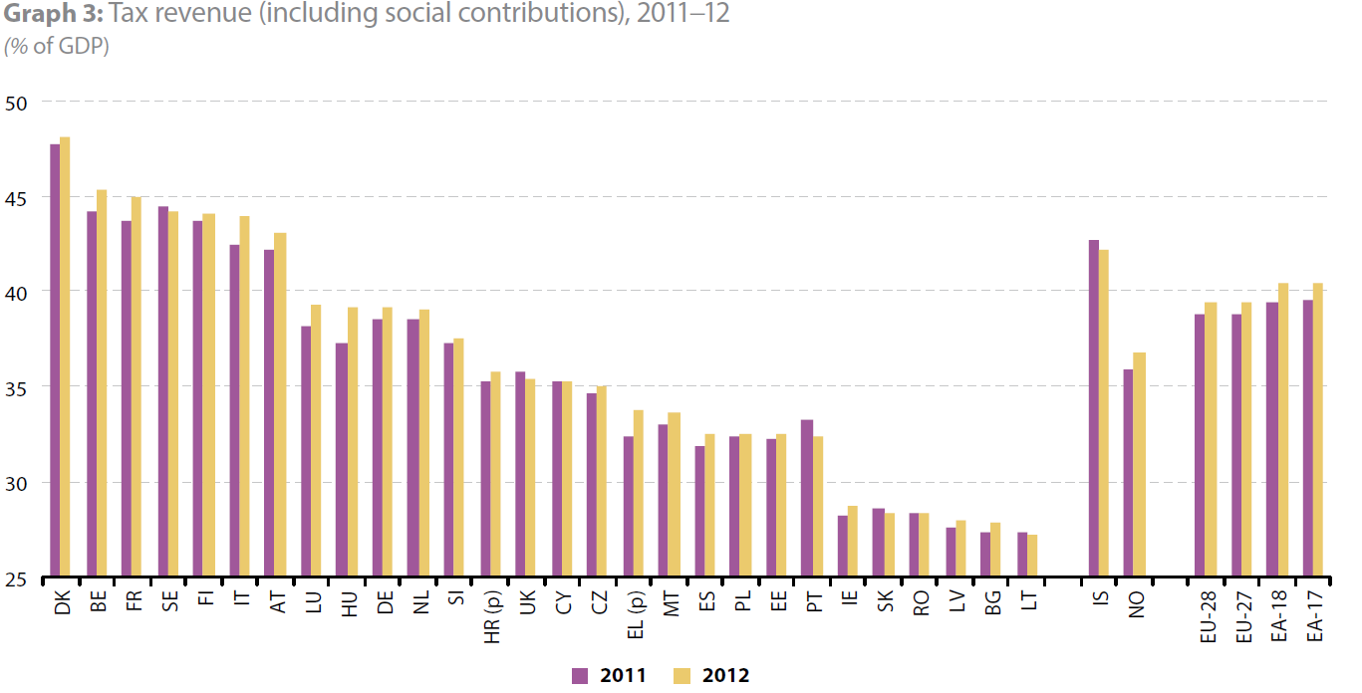

Slide 16
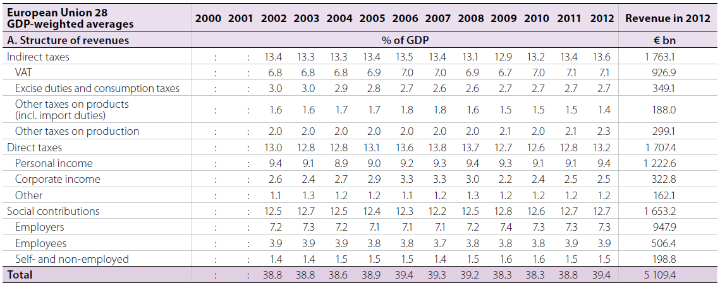

Slide 17
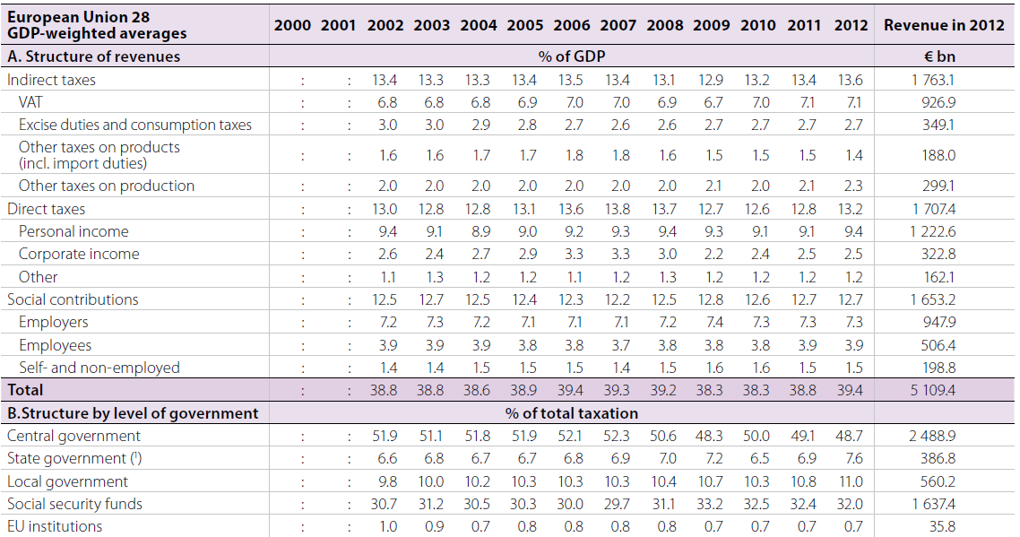

Slide 18
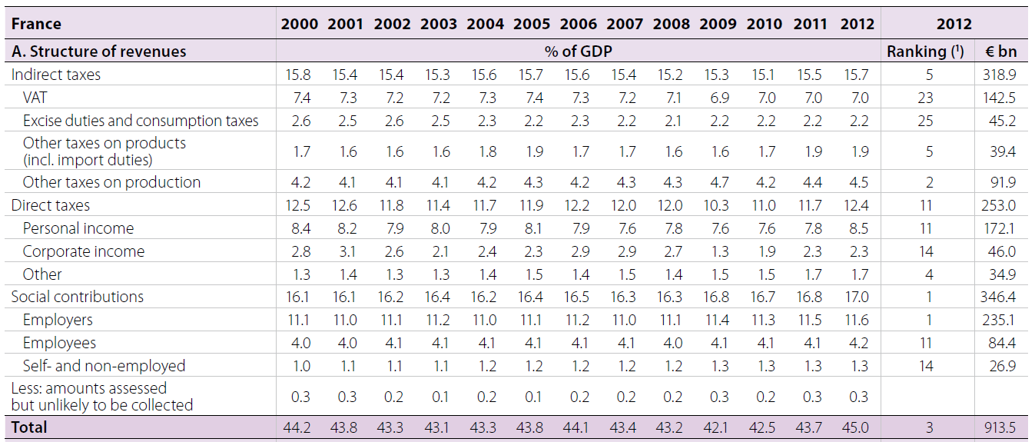

Slide 19
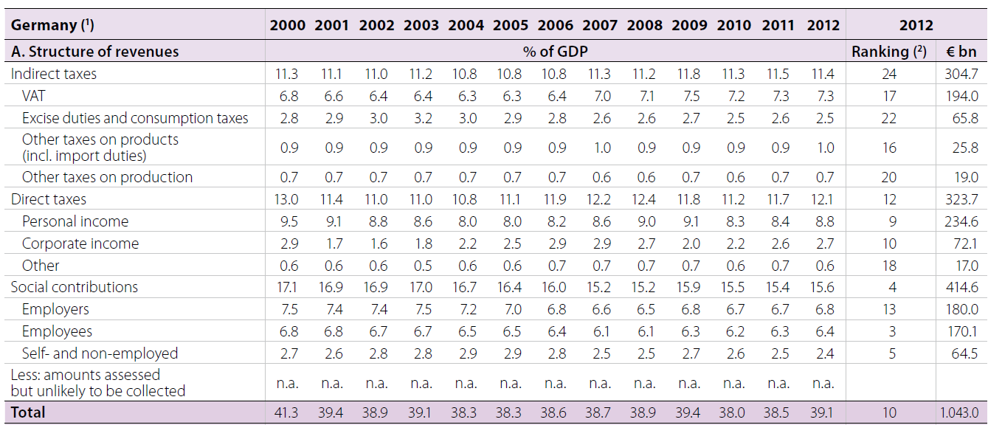

Slide 20
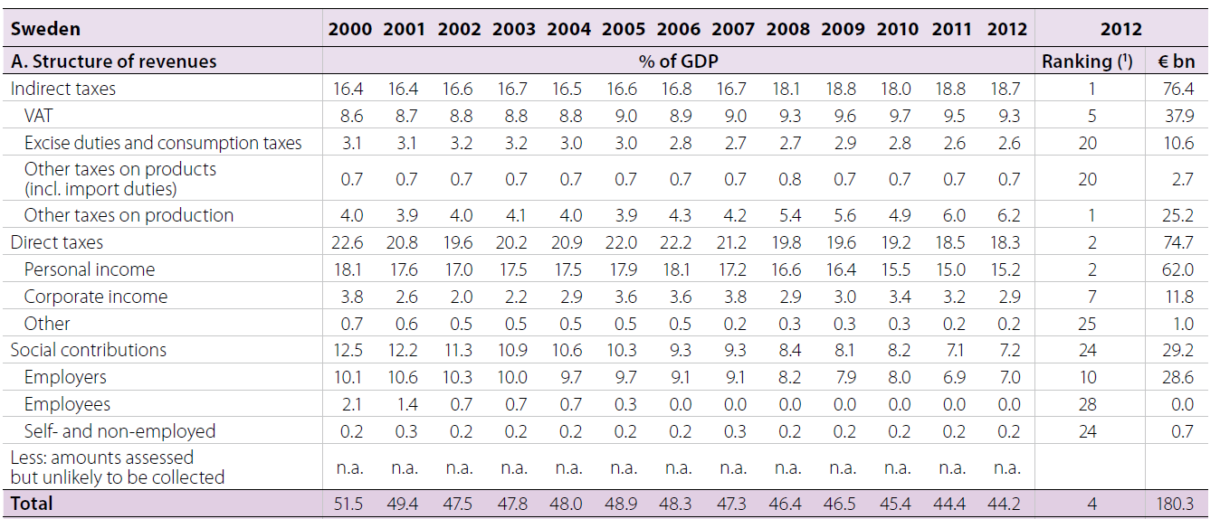

Slide 21
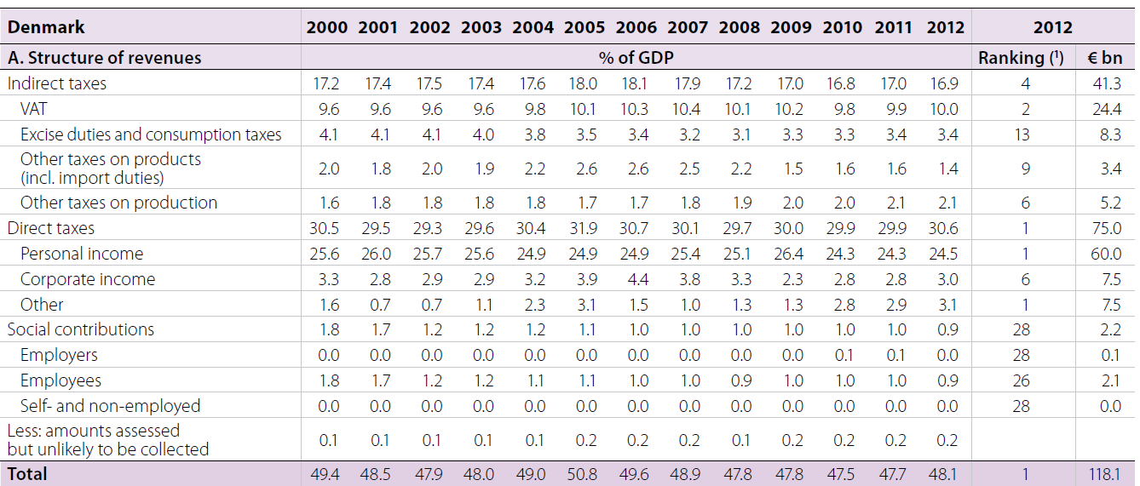

Slide 22
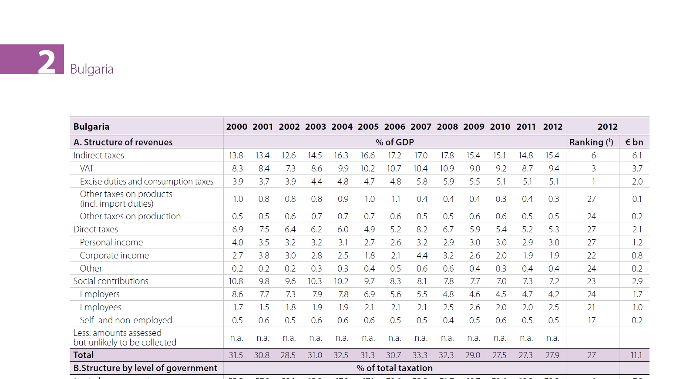

Slide 23
Basic facts about taxes and transfers in developing countries
In poor countries: T = as low as 10%-15% of national income Y. The ratio T/Y has been stagnating in recent decades: declining trade tax revenues were not replaced by more modern income or value added taxes.
See Cage-Gadenne 2014, "The Fiscal Cost of Trade Liberalization"
See also Latin America Revenue Statistics (large differences, e.g. Mexico-Chile vs Argentina-Brasil)

Slide 24
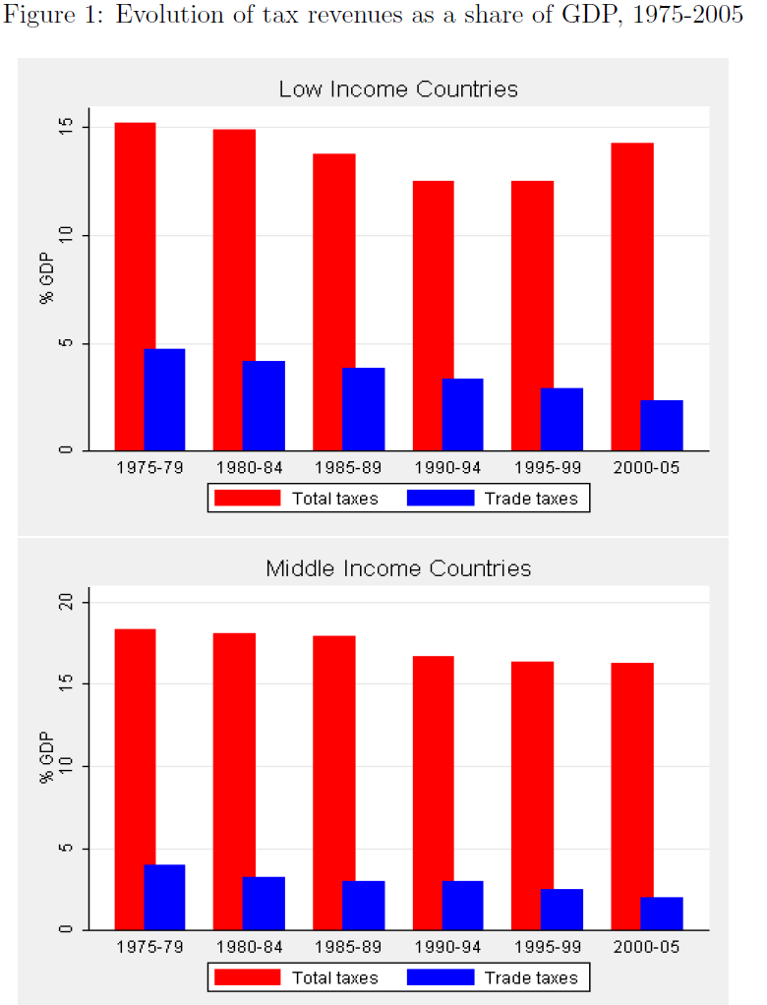
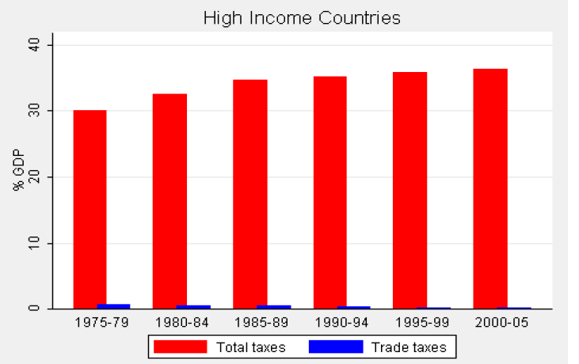

Slide 25
Optimal tax policy: social objective vs tax and transfer incidence
How can we formulate the problem of socially optimal tax and transfer policy?
One needs to specify the social objective: « maximin » redistributive objective (maximize welfare of individuals with minimal welfare level) (≈ minimize poverty), output maximization (no redistributive objective at all), etc.
→ see Lecture 2
And one needs to analyze the incidence of taxes & transfers: i.e. what is the impact of taxes and transfers on economic transactions, supply and demand, prices, etc.; key question: at the end of the day, who pays what, and who receives what?
→ see today for an introduction to the pb of tax incidence, and see Lectures 3-7 for more precise analysis in the case of taxes on income, wealth and carbon

Slide 26
Tax & transfer incidence: macro approach
Tax incidence problem = the central issue of public economics = who pays what?
General principle: it depends on the various elasticities of demand and supply on the relevant labor market, capital market and goods market.
Usually the more elastic tax benefit wins, i.e. the more elastic tax base shifts the tax burden towards the less elastic
Same pb with transfer incidence: who benefits from housing subsidies: tenants or landlords? – this depends on elasticities
Opening up the black box of national accounts tax aggregates is a useful starting point in order to study factor incidence (macro approach)
But this needs to be supplemented by micro studies

Slide 27
Standard macro assumptions about tax incidence
Closed economy: domestic output = national income = capital + labor income = consumption + savings
Y = F(K,L) = Y_{K}+Y_{L} = C+S
Total taxes = capital taxes + labor taxes + consumpt. taxes
T = τY = T_{K}+T_{L}+T_{C} = τ_{K}Y_{K} + τ_{L}Y_{L} + τ_{C} C
See Eurostat estimates of τ_{L}, τ_{K}, τ_{C}
Typically, τ_{L}=35%-40%, τ_{K}=25%-30%, τ_{C}=20%-25%.
But these computations make assumptions: all labor taxes (incl. all social contributions, employer & employee) are paid by labor; all capital taxes (incl. corporate tax) paid by capital; not necessarily justified
Open economy tax incidence: Y + Imports = C + I + Exports
→ taxing imports: major issue with VAT (fiscal devaluation)

Slide 28
Basic tax incidence model
Output Y = F(K,L) = Y_{K} + Y_{L}
Assume we introduce a tax τ_{K} on capital income Y_{K} , or a tax τ_{L} on labor income Y_{L}
Q.: Who pays each tax? Is a capital tax paid by capital and a labor tax paid by labor?
A.: Not necessarily. It depends upon:
the elasticity of labor supply e_{L}
- the elasticity of capital supply e_{K}
the elasticity of substitution σ between K & L in the production function (which in effect determines the elasticities of demand for K & L)

Slide 29
Reminder: what is capital?
K = real-estate (housing, offices..), machinery, equipment, patents, immaterial capital,..
(≈ housing assets + business assets: about 50-50)
Y_{K} = capital income = rent, dividend, interest, profits,..
In rich countries, β = K/Y = 5-6 (α = Y_{K}/Y = 25-30%)
(i.e. average rate of return r = α/β = 4-5%)
Typically, in France, Germany, UK, Italy, US, Japan: Y ≈ 30 000€ (pretax average income, i.e. national income /population), K ≈ 150 000-180 000€ (average wealth, i.e. capital stock/population); net foreign asset positions small in most coutries (but rising); see this graph & economic history course for more details

Slide 30
Back to tax incidence model
Simple (but unrealistic) case: linear production function
Y = F(K,L) = r K + v L
With r = marginal product of capital (fixed)
v = marginal product of labor (fixed)
Both r and v are fixed and do not depend upon K and L = infinite substituability between K and L = zero complementarity = robot economy
Then capital pays capital tax, & labor pays labor tax (it’s like two separate markets, with no interaction)
Revenue maximizing tax rates:
τ_{K} = 1/(1+e_{K}) , τ_{L} = 1/(1+e_{L})
(= inverse-elasticity formulas)

Slide 31
The inverse-elasticity formula τ = 1/(1+e)
Definition of labor supply elasticity e_{L} : if the net-of-tax wage rate (1-τ_{L})v rises by 1%, then labor supply L (hours of work, labor intensity, skills, etc.) rises by e_{L}%
If the tax rate rises from τ_{L} to τ_{L}+dτ , then the net-of-tax wage rate drops from (1-τ_{L})v to (1-τ_{L}-dτ )v , i.e. drops by dτ/(1-τ_{L}) %, so that labor supply drops by e_{L} dτ/(1-τ_{L}) %
Therefore tax revenue T = τ_{L}vL goes from T to T+dT with:
dT = vL dτ – τ_{L}v dL = vL dτ – τ_{L}vL e_{L} dτ/(1-τ_{L})
I.e. dT = 0 ↔ τ_{L} = 1/(1+e_{L}) (= top of the Laffer curve)
Same with capital tax τ_{K}. Definition of capital supply elasticity e_{K} : if the net-of-tax rate of return (1-τ_{K})r rises by 1%, then capital supply K (i.e. cumulated savings, inheritance, etc.) rises by e_{K}%
More on inverse-elasticity formulas in Lectures 2-7

Slide 32
Tax incidence with capital-labor complementarity
Cobb-Douglas production function: Y = F(K,L) = K^{α} L^{1-α}
With perfect competition, wage rate = marginal product of labor, rate of return = marginal product of capital:
r = F_{K} = α K^{α-1} L^{1-α} and v = F_{L} = (1-α) K^{α} L^{-α}
Therefore capital income Y_{K} = r K = α Y
& labor income Y_{L} = v L = (1-α) Y
I.e. capital & labor shares are entirely set by technology (say, α=30%, 1-α=70%) and do not depend on quantities K, L
Intuition: Cobb-Douglas ↔ elasticity of substitution between K & L is exactly equal to 1
I.e. if v/r rises by 1%, K/L=α/(1-α) v/r also rises by 1%. So the quantity response exactly offsets the change in prices: if wages ↑by 1%, then firms use 1% less labor, so that labor share in total output remains the same as before

Slide 33
Assume τ_{L} → τ_{L}+dτ. Then labor supply drops by dL/L=- e_{L} dτ/(1-τ_{L})
This in turn raises v by dv & reduces r by dr and K by dK.
In equilibrium: dv/v = α (dK/K – dL/L), dr/r = (1-α) (dL/L – dK/K)
dL/L = - e_{L} [dτ/(1-τ_{L}) – dv/v] , dK/K = e_{K} dr/r
→ dv/v = αe_{L}/[1+αe_{L}+(1-α)e_{K}] dτ/(1-τ_{L})
dr/r = -(1-α)e_{L}/[1+αe_{L}+(1-α)e_{K}] dτ/(1-τ_{L})
Assume e_{L}=0 (or e_{L} infinitely small as compared to e_{K}).
Then dv/v = 0. Labor tax is entirely paid for labor.
Assume e_{L}=+∞ (or e_{L} infinitely large as compared to e_{K}).
Then dv/v = dτ/(1-τ_{L}). Wages rise so that workers are fully compensated for the tax. Labor tax is entirely shifted to capital.
The same reasonning applies with capital tax τ_{K} → τ_{K}+dτ.
I.e. if e_{K} infinitely large as compared to e_{L}, a capital tax is entirely shifted to labor, via higher pretax profits and lower wages.

Slide 34
Tax incidence with general production function
CES : Y = F(K,L) = [a K^{(σ-1)/σ} + (1-a) L^{(σ-1)/σ} ]^{σ/(σ-1)}
(=constant elasticity of substitution equal to σ)
σ →∞: back to linear production function
σ →1: back to Cobb-Douglas
σ →0: F(K,L)=min(rK,vL) (« putty-clay », fixed coefficients)
r = F_{K} = a β^{-1/σ} (with β=K/Y), i.e. capital share α = r β = a β^{(σ-1)/σ} is an increasing function of β if and only if σ>1 (and stable iff σ=1)
Tax incidence: same conclusions as before, except that one now needs to compare σ to e_{L} and e_{K}:
if σ large as compared to e_{L},e_{K}, then labor pays labor taxes & capital pays capital taxes
if e_{L} large as compared to σ,e_{K}, then labor taxes shifted to K
if e_{K} large as compared to σ,e_{L}, then capital taxes shifted to L

Slide 35
What do we know about σ, e_{L}, e_{K} ?
Labor shares 1-α seem to be relatively close across countries with different tax systems, e.g. labor share are not larger in countries with large social contributions → labor taxes seem to be paid by labor; this is consistent with e_{L} relatively small
Same reasonning for capital shares α: changes in corporate tax rates do not seem to lead to changes in capital shares
β=K/Y is almost as large in late 20c-early 21c as in 19c-early 20c, despite much larger tax levels (see graphs 1, 2, 3) → this is again consistent with e_{K} relatively small
Historical variations in capital shares α = r β tend to go in the same direction as variations in β (see graphs 1, 2)
→ this is consistent with σ somewhat larger than 1
If σ is large as compared to e_{L}, e_{K}, then the standard macro assumptions about tax incidence are justified

Slide 36
But these conclusions are relatively uncertain: it is difficult to estimate macro elasticities
Also they are subject to change. E.g. it is possible that σ tends to rise over the development process. I.e. σ<1 in rural societies where capital is mostly land (see Europe vs America: more land in volume in New world but less land in value; price effect dominates volume effects: σ<1). But in 20c & 21c, more and more uses for capital, more substitution: σ>1. Maybe even more so in the future. Capital is multidimensional: σ varies.
Elasticities do not only reflect real economic responses. E.g. e_{K} can be large for pure accounting/tax evasion reasons: even if capital does not move, accounts can move. Without fiscal coordination between countries (unified corporate tax base, automatic exchange of bank information,..), capital taxes might be more and more shifted to labor.

Slide 37
Some recent research on the incidence of social security contributions:
A. Bozio, T. Breda, M. Guillot, « Taxes and technological determinants of wage inequalities: France 1976-2014 », PSE 2016.
Inequalities of total labor costs rose in France, with no rise in inequalities of net wages, thanks to rising progressivity of social security contributions.
A. Bozio, T. Breda, J. Grenet, «Incidence of Social Security Contributions: Evidence from France », PSE 2016.
Incidence varies greatly with the degree of contribution-benefit linkage (near-complete employee incidence if high linkage, regardless of e_{s} and e_{d})

Slide 38
Micro estimates of tax incidence
Micro estimates allow for better identification of elasticities… but usually they are only valid locally, i.e. for specific markets
Illustration with the incidence of housing benefits:
G. Fack "Are Housing Benefits An Effective Way To Redistribute Income? Evidence From a Natural Experiment In France", Labour Economics 2006. See paper.
One can show that the fraction θ of housing benefit that is shifted to higher rents is given by θ = e_{d}/(e_{d}+e_{s}), where e_{d} = elasticity of housing demand, and e_{s} = elasticity of housing supply
Intuition: if e_{s}=0 (i.e. fixed stock of housing, no new construction), and 100% of housing benefits go into higher rents
Using extension of housing benefits that occured in France in the 1990s, Fack estimates that θ = 80%. See graphs.
The good news is that it also works for taxes: property owners pay property taxes (Ricardo: land should be taxed, not subsdized)

Slide 39
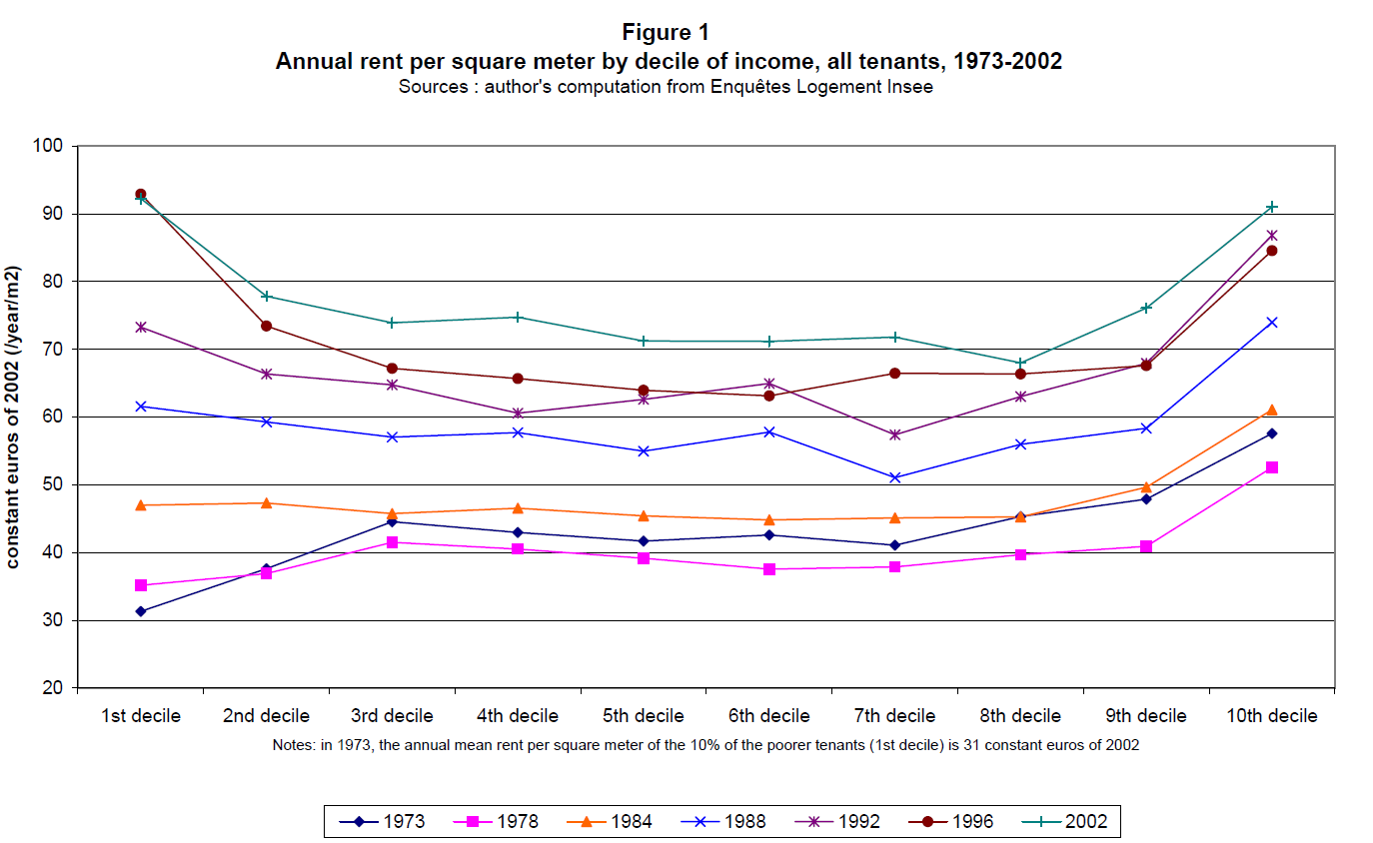

Slide 40
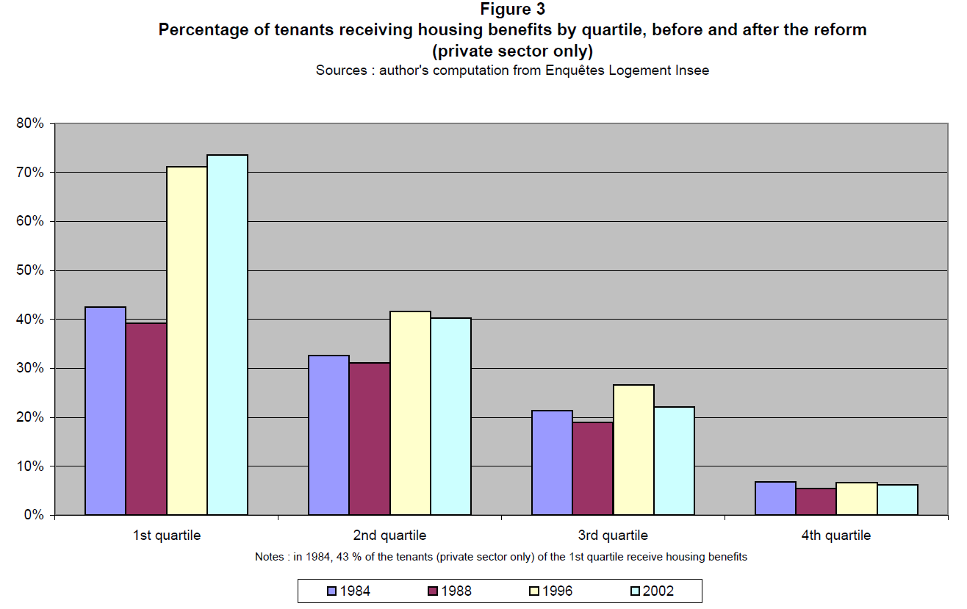

Slide 41
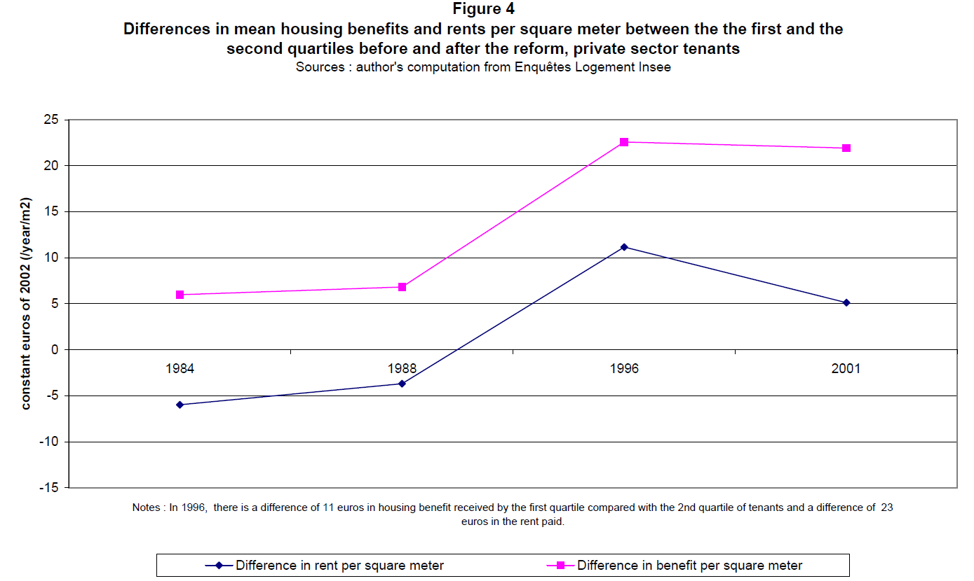

Slide 42
Illustration with the incidence of value added taxes (VAT):
C. Carbonnier, “Who Pays Sales Taxes ? Evidence from French VAT Reforms, 1987-1999”, Journal of Public Economics 2007. See paper.
Q.: Is the VAT a pure consomption tax? Not so simple
First complication. Valued added = output – intermediate consumption = wages + profits. I.e. value added = Y = Y_{K} + Y_{L} = C + S
So is the VAT like an income tax on Y_{K} + Y_{L} ? No, because investment goods are exempt from VAT, and I = S in closed economy
Second complication. Even if VAT was a pure tax on C, this does not mean that it entirely shifted on consumer prices. VAT is always partly shifted on prices and partly shifted on factor income (wages & profits). How much exactly depends on the supply & demand elasticities for each specific good or service.

Slide 43
One can show that the fraction x of VAT that is shifted to prices is given by x = e_{s}/(e_{d}+e_{s}), where e_{d} = elasticity of demand for this good, and e_{s} = elasticity of supply for this good
Intuition: if e_{s} is very high (very competitive sector and easy to increase supply), then a VAT cut will lead to a large cut in prices (but less than 100%); conversely if e_{s} is small (e.g. because increasing production requires a lot of extra capital and labor that is not easily available), then producers will keep a lot of VAT cut for themselves; it is important to understand that it will happen even with perfect competition
Using all VAT reforms in France over 1987-1999 period, Carbonnier finds x=70-80% for sectors such as repair services (e_{s} high) and x=40-50% for sectors such as car industry (requires large investment). See graphs.

Slide 45
